Slide 1
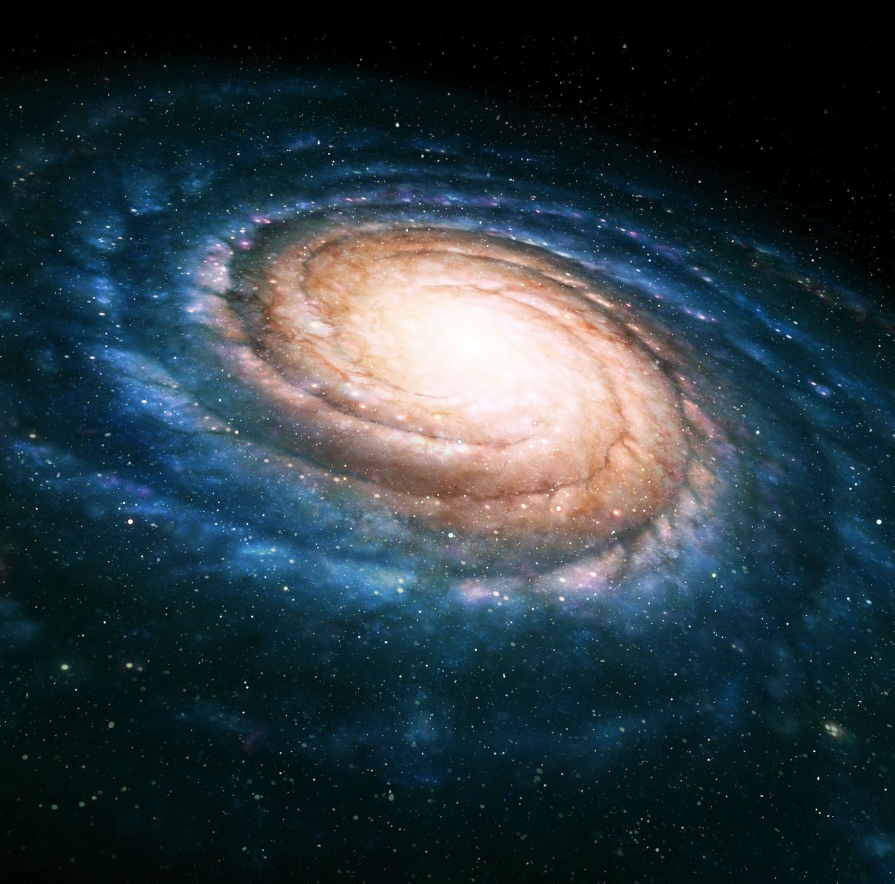
Meteor Madness
camel_case

Slide 2
Why did we pick this challenge?
Best fit for our skill set →
Data Analysis
Simulation/Modelling
Potential Asteroid collision in the news this year.
Interesting, yet not overly complicated first project.

Slide 3
Roles and Collaboration
Github was an important tool for this project.
Josh and Arnav → Modelling and Simulation
Alan and Anav → Data Analysis
Oisín → UI design
Kyle → WebApp and project coordinator.

Slide 4

Project Overview

Slide 5
Data Analysis and Calculations.
Alan and Anav were in the trenches for five hours of the project, battling with unfriendly imports and lack of knowledge of orbital mechanics.
However, as things started to take shape, and as insight was gained into how our APIs worked. They were increasingly able to assist in the integration of their code into our Unity simulation

Slide 6
Simulation and Modelling
This was easily the most complex part of our project, and required all hands on deck.
Arnav and Josh used Unity to simulate Asteroid impacts based on input data from Python.

